Slide 1
Windows 10 Virtual Desktops and Window Management

Slide 2
More about Virtual Desktop
It’s like multiple monitors, but you have to switch between them.
Great for organizing tasks to quickly switch between.
No external software required.
Available on all computers running Windows 10
Usable through remote desktop

Slide 3
How to access Virtual Desktops
Virtual Desktops can be accessed using the button next to the search on the taskbar

Slide 4
What does each desktop do?
Each of these can be thought of as a workspace
You can have as few or as many as you’d like
Hovering over a desktop and then hitting the X will remove a desktop
Hitting the New Desktop + button will add another desktop.

Slide 5
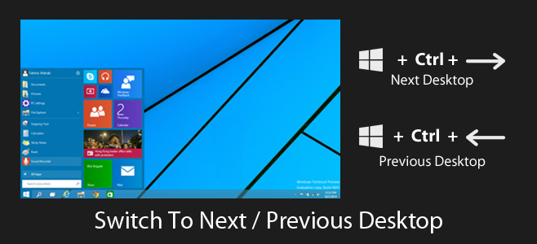
How to move between desktops
You can move between desktops by hitting the virtual desktop button and clicking on a desktop.
You can also slide between desktops by using the key combination of ctrl+windows key+left or right arrow.

Slide 6
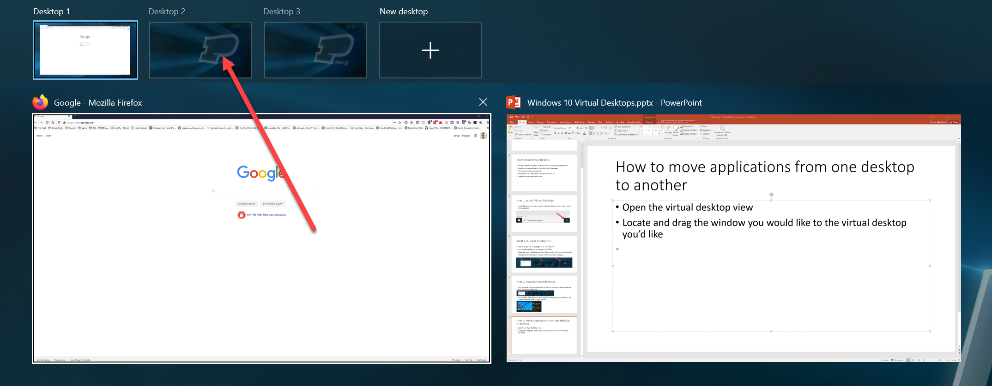
How to move applications from one desktop to another
Open the virtual desktop view
Locate and drag the window you would like to the virtual desktop you’d like

Slide 7
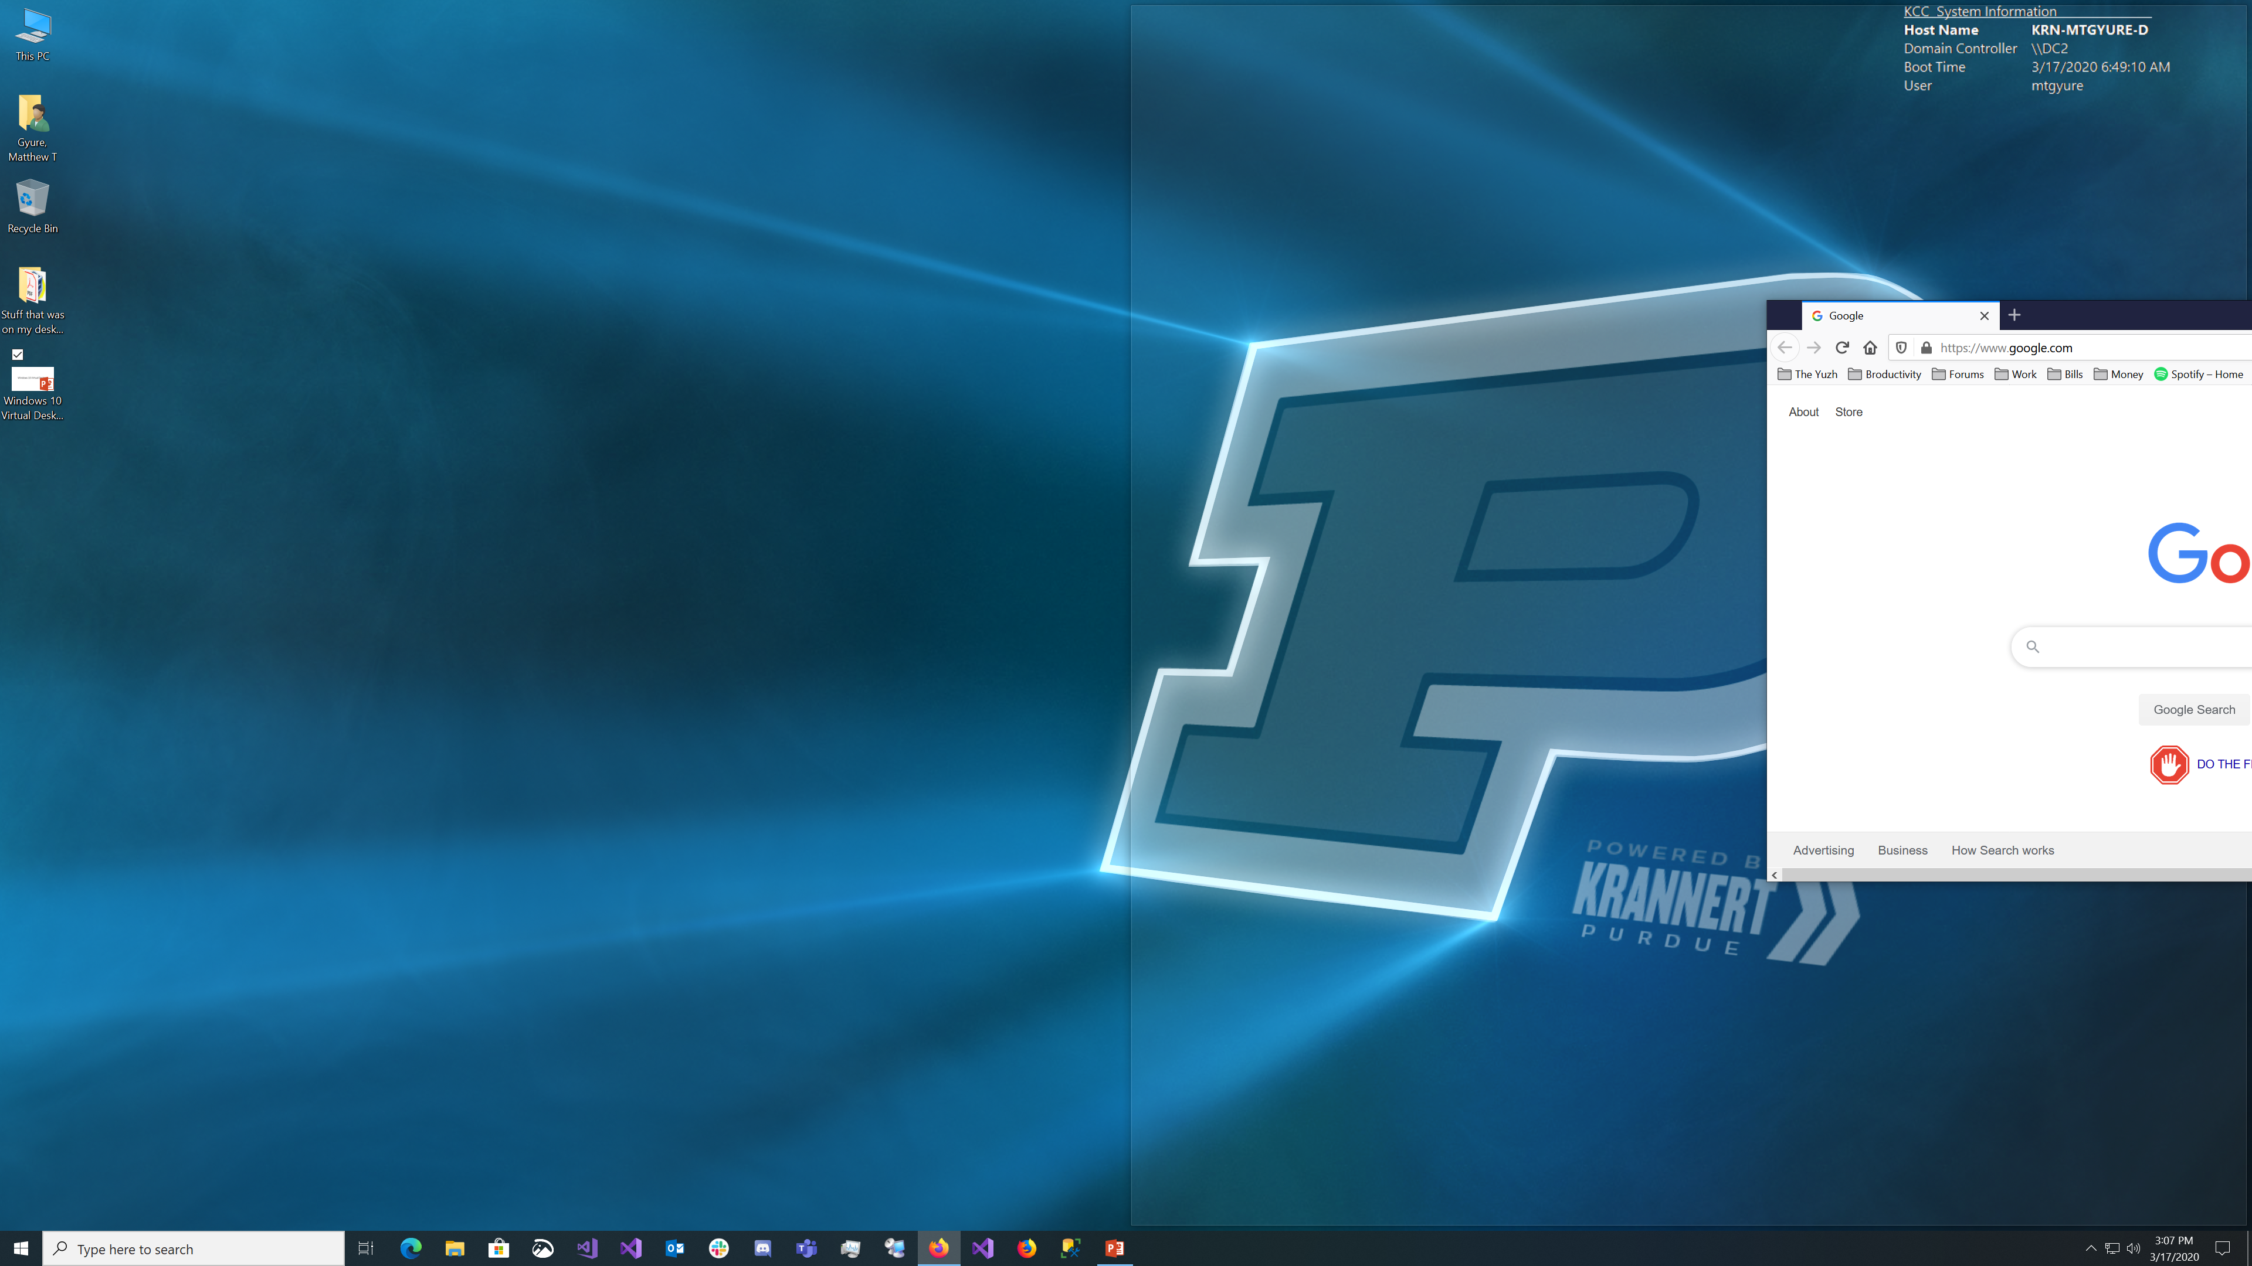
Organize your windows
You can also manage your windows on each desktop to maximize space
By taking a window and dragging it to a side and waiting until you see a shadow like the one picture to take up half the screen
You can also drag a window to any of the four corners to take up ¼ the screen.

Slide 8
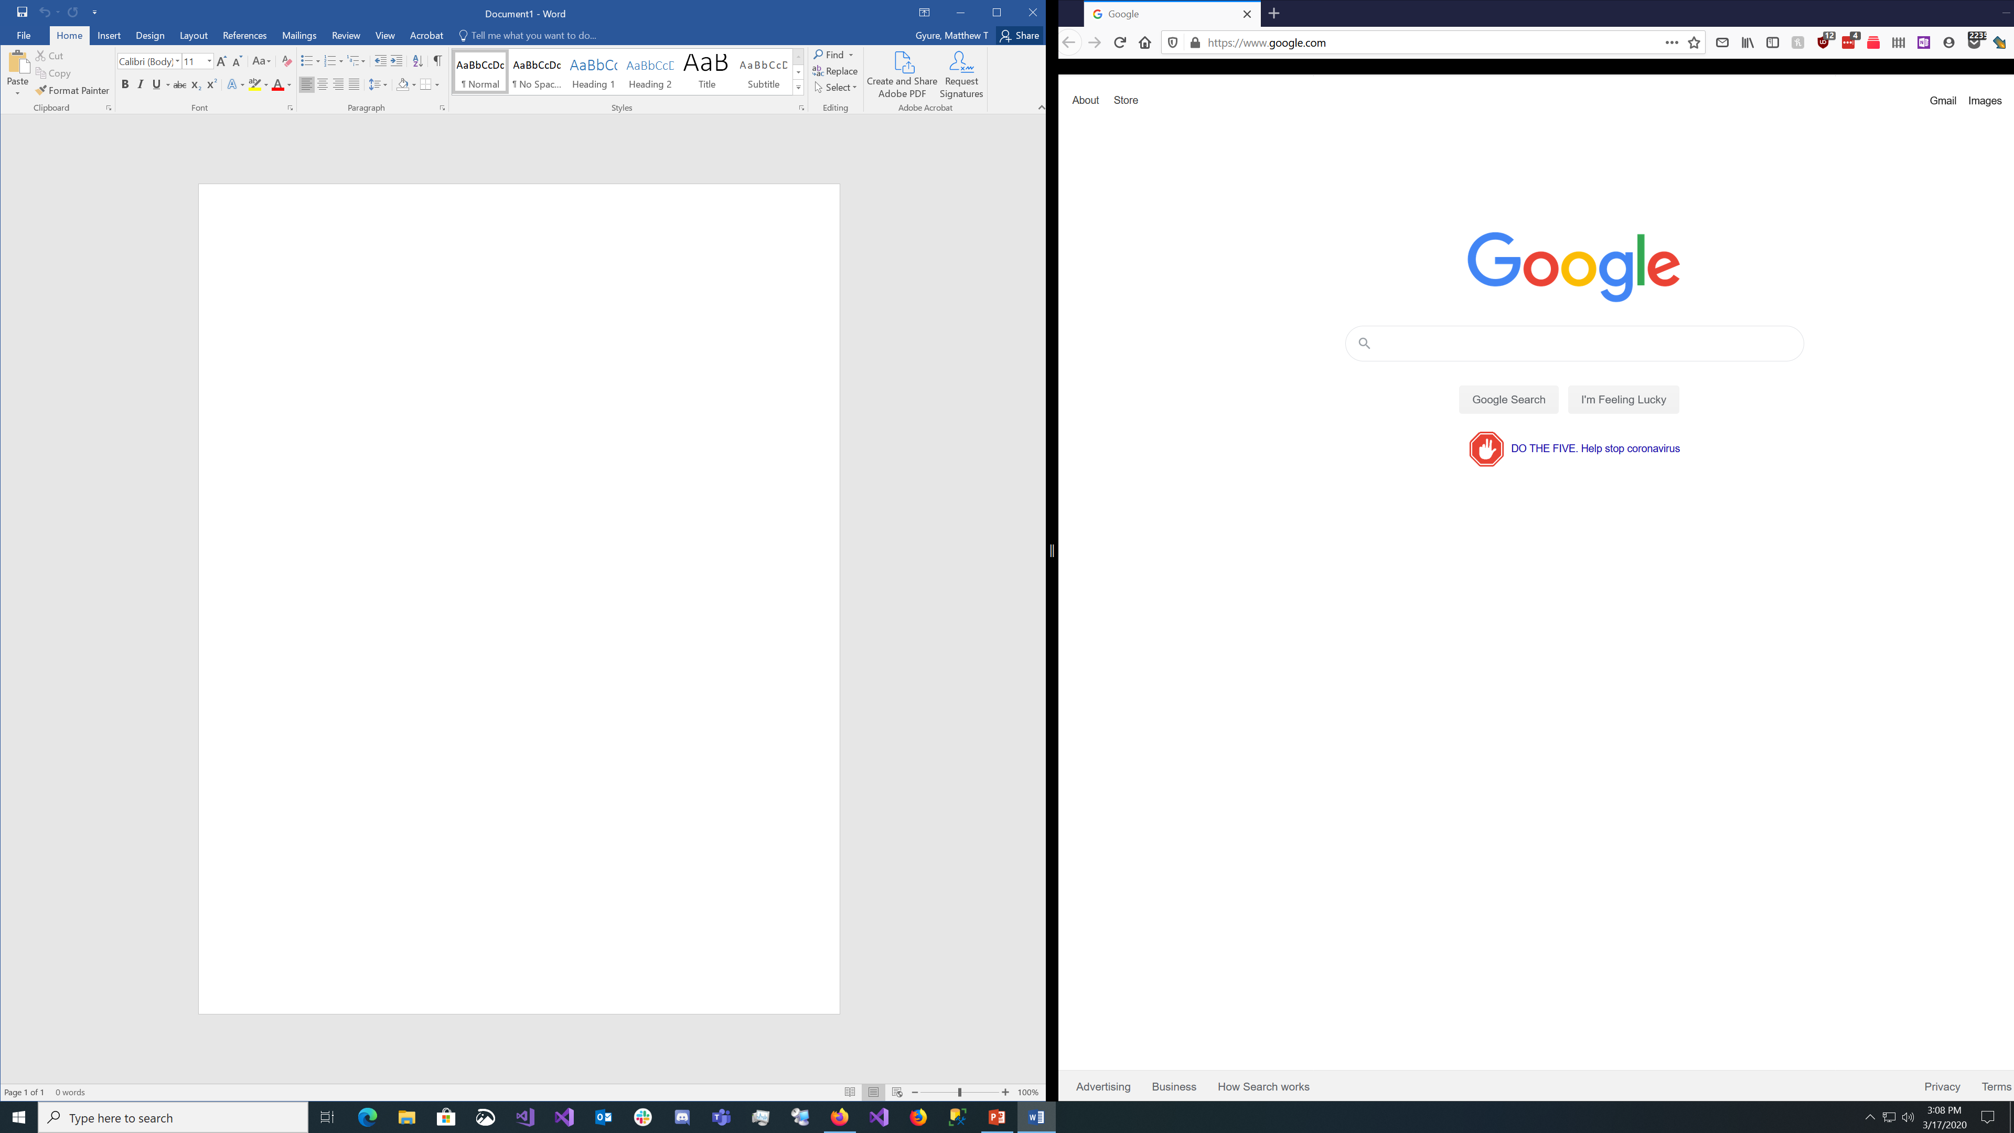
Resizing windows
When windows are side by side, you can drag the bar in the window to se the windows as you see fit.
Just click between the windows and drag like pictured below

